Slide 1
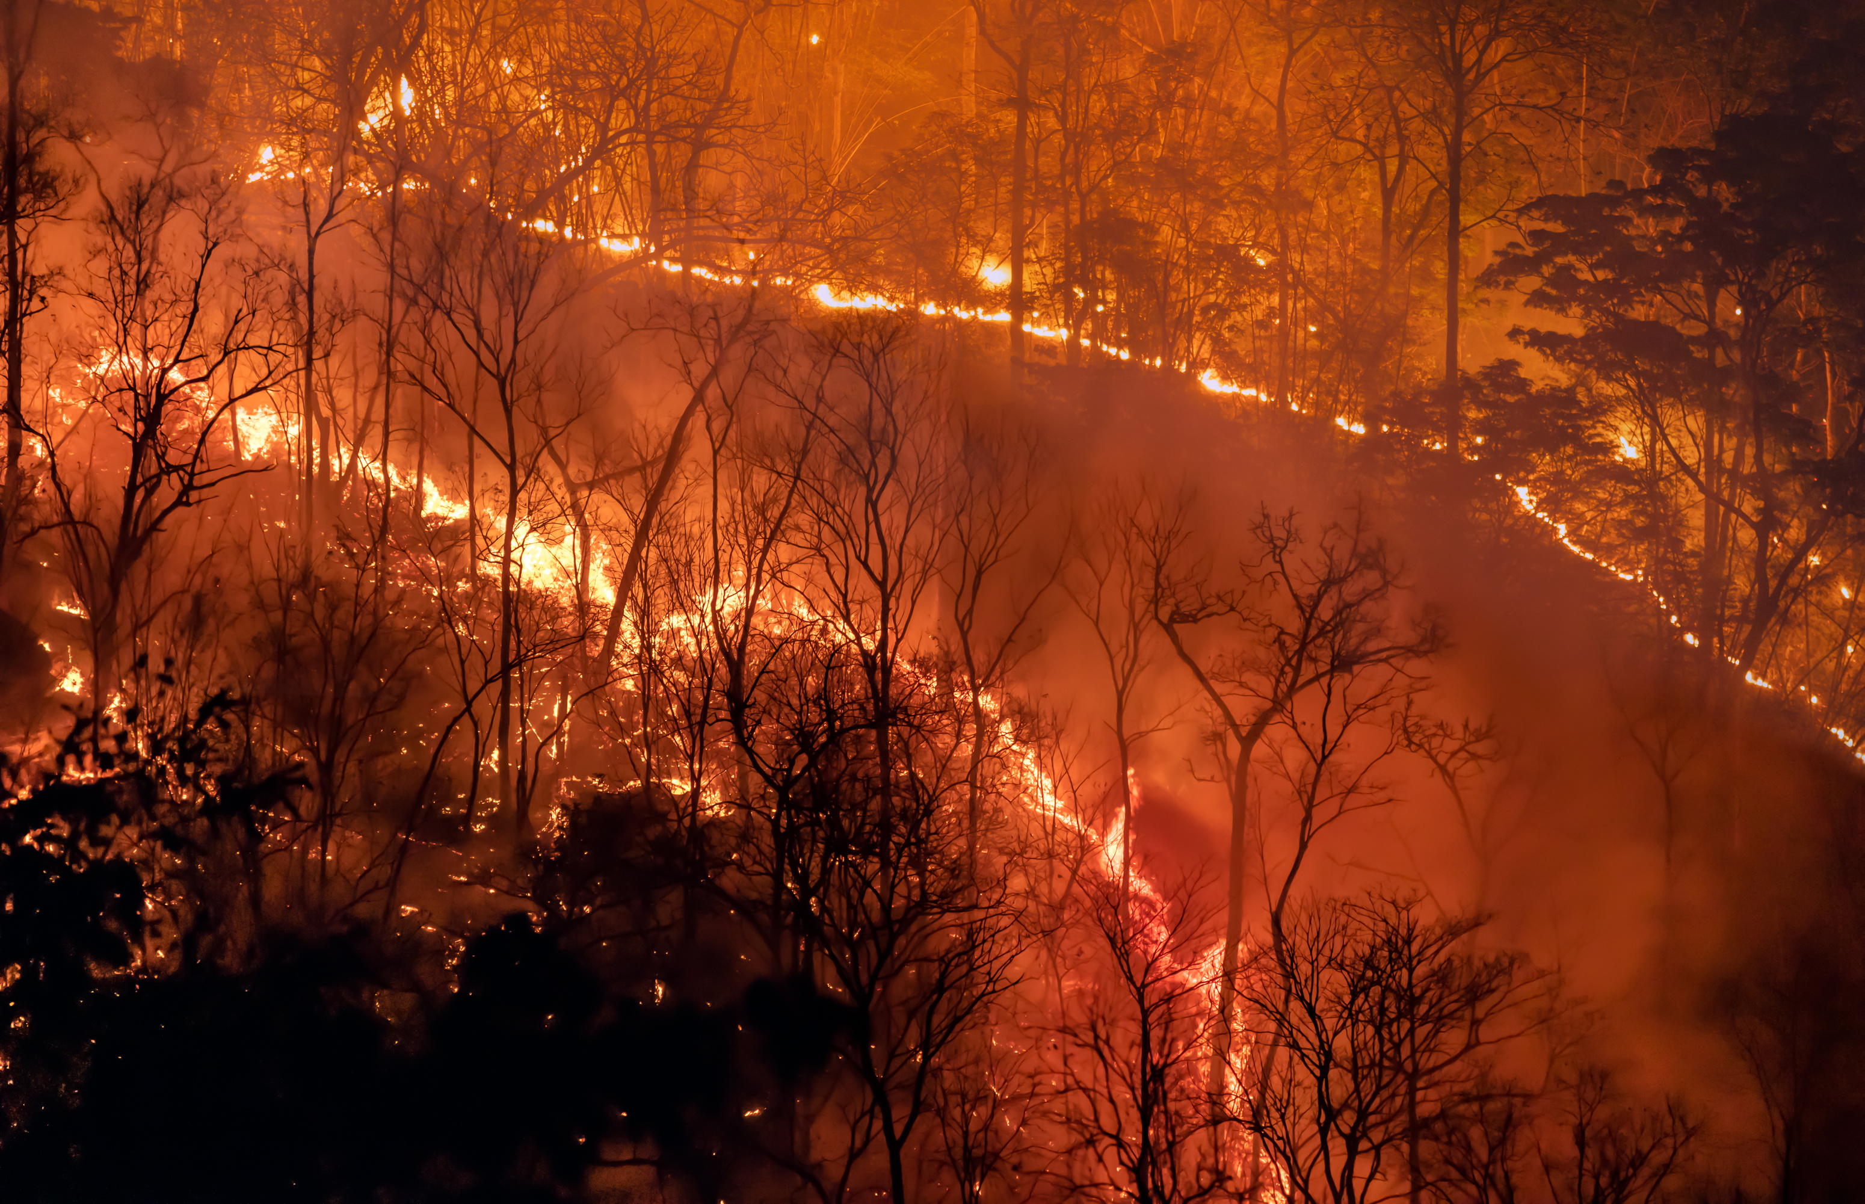
The Wildfire Prediction in California by Machine Learning
CIS5560-Group 6
Serena Tang, Sophathriya Sen, Lee, Christopher
May.7th 2025
Notes:
https://csula-my.sharepoint.com/:p:/r/personal/xtang13_calstatela_edu/Documents/Calstatela%202024fall/2025%20Spring/5560/Term%20Project/Project%20Document/CIS5560_group6_California%20Wildfire%20Prediction%20by%20Machine%20Learning.pptx?d=w010a90b48b334ed2a5f12b8fff62f42e&csf=1&web=1&e=KenRJv

Slide 2
Data and Server Specifications
Project Idea Explanation
Project Architecture and workflow
Data Process
Machine Learning Model Building and Testing

Slide 3
Data and Server Specifications
Data Size and Source
Data Size: 7.17 GB
Data Coverage: 2020 -2021
Data Source URL:
https://developers.google.com/earth-engine/datasets/catalog
H/W experimental Specifications
Cluster version: Oracle (ODH)
Cluster number of nodes: 5
Memory size: 31 GB
CPU speed: 2.45 GHz

Slide 4
Data and Server Specifications
Project Idea Explanation
Project Architecture and workflow
Data Process
Machine Learning Model Building and Testing

Slide 5
Project Idea
Data Overview:
Historical Wildfire Impact Data of the national range 2020-2021;
Meteorological Data of the national range 2021;
Vegetation and Land Cover Data of the national range 2021;
Topography Data of the national range;
Human Activity Data of the national range 2020-2021;
Nine Features Datasets:
Burned Area/Temperature/Humidity/Precipitation/ Landcover/ Elevation/ Slope/ Aspect/ Population Density
Project Originality:
1) The latest datasets after the wildfire in California.
2) Use GeoTIFF to build the ML model for wildfire prediction.
3) We use both regression models and classification models;
4) Compare the four models’ accuracy to find the best model.

Slide 6
Data and Server Specifications
Project Idea Explanation
Project Architecture and workflow
Data Process
Machine Learning Model Building and Testing

Slide 7
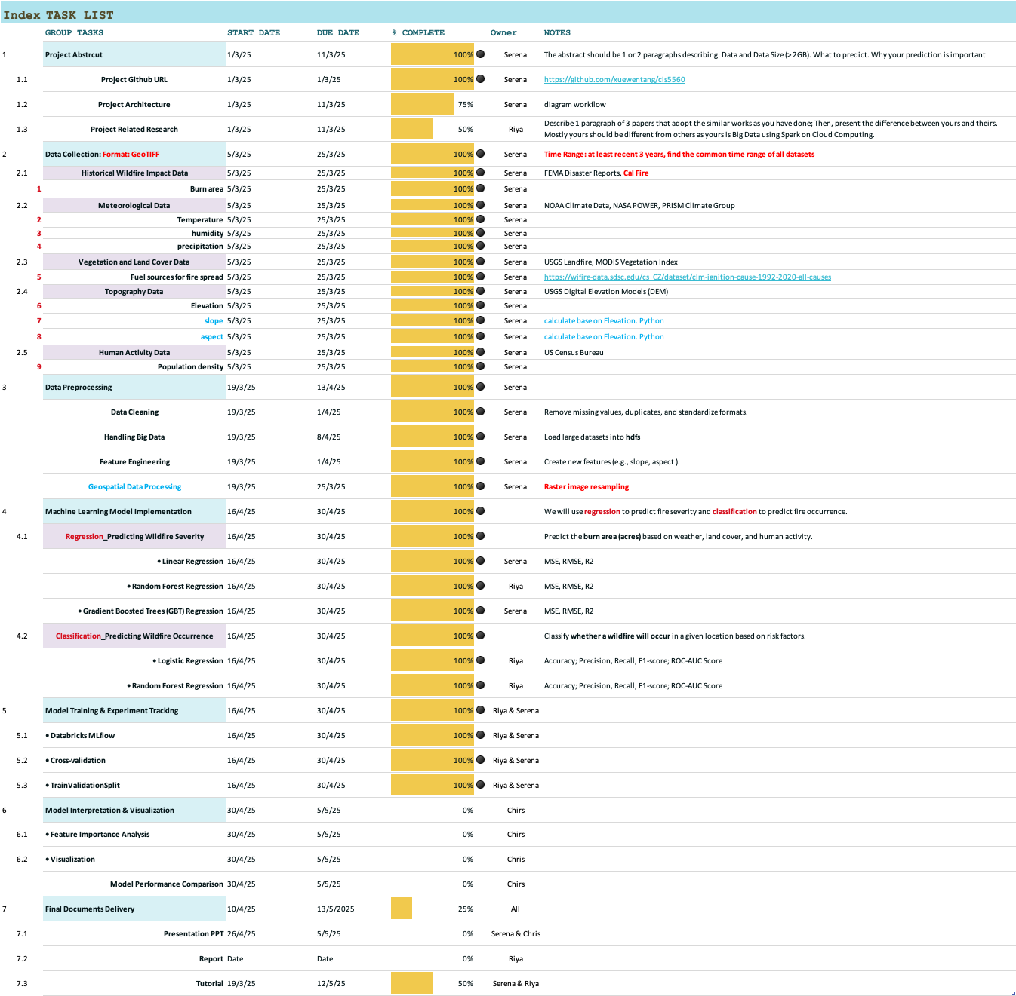
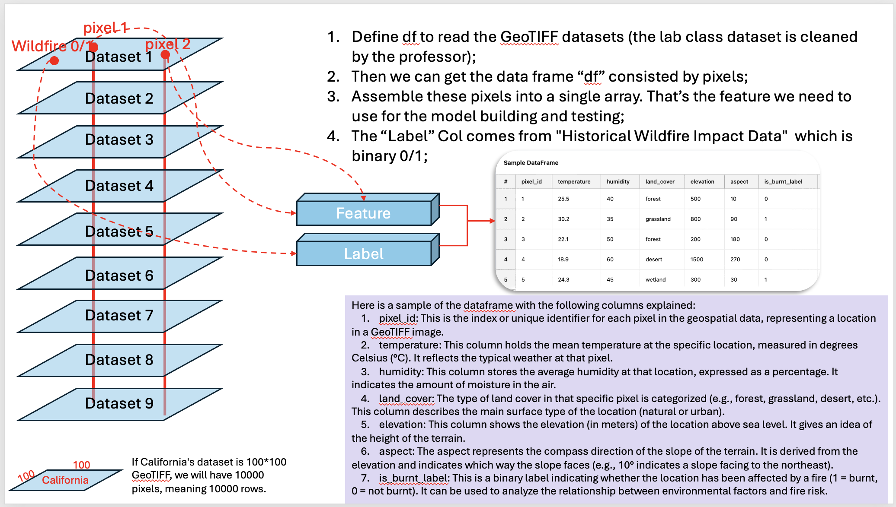
Project Architecture

Slide 8
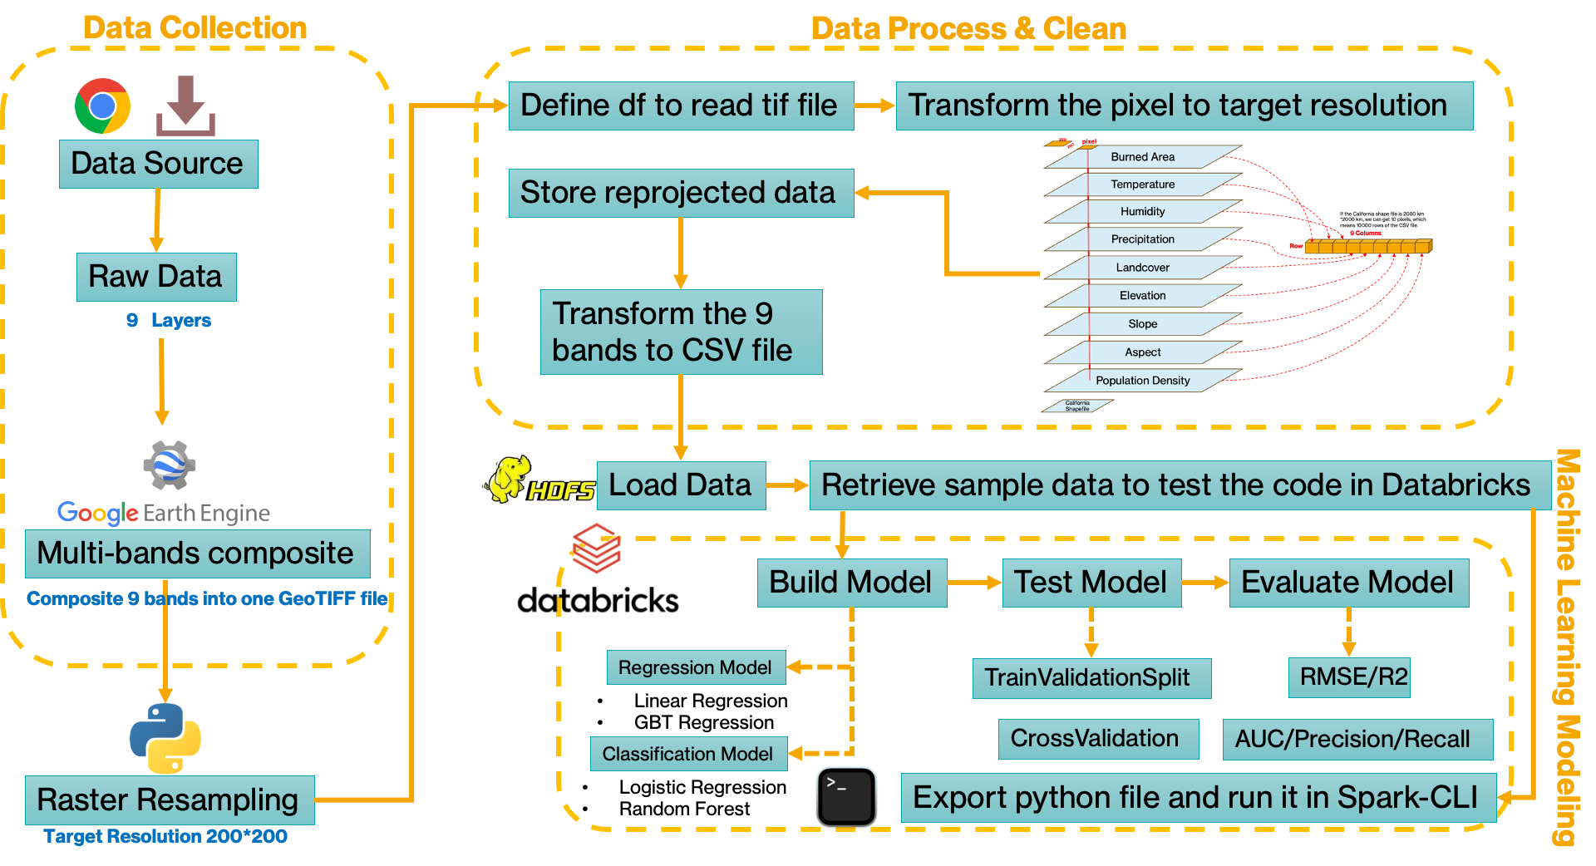
Project Workflow

Slide 9
Data and Server Specifications
Project Idea Explanation
Project Architecture and workflow
Data Process
Machine Learning Model Building and Testing

Slide 10
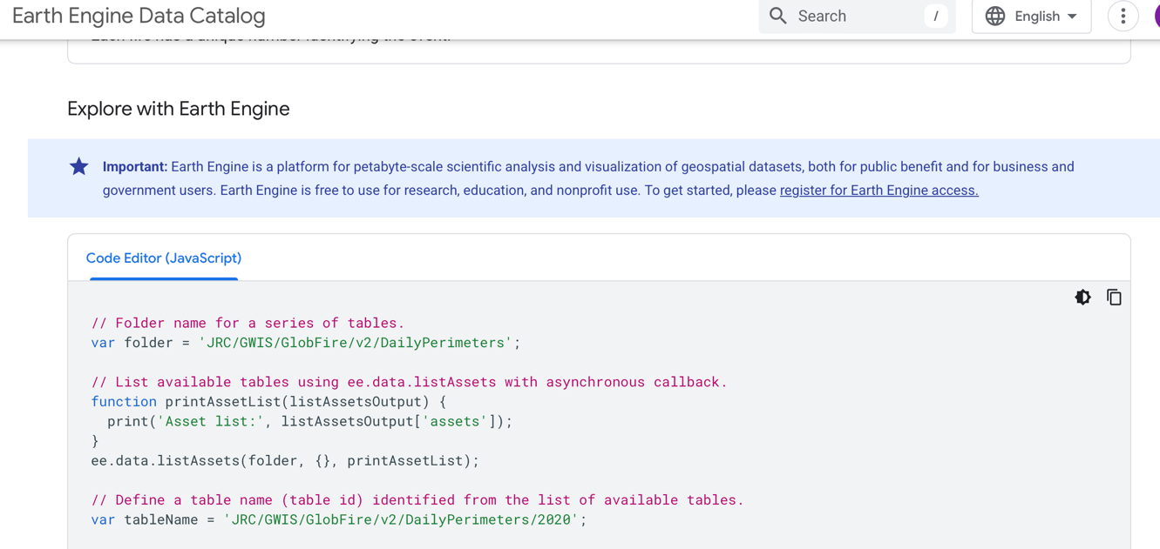
Data Process-Data Collection
Historical Wildfire Impact Data | 2020-2021 | SIZE
Burn area | https://developers.google.com/earth-engine/datasets/catalog/JRC_GWIS_GlobFire_v2_DailyPerimeters#description | 62.95*2MB
Meteorological Data | 2021
Temperature | https://developers.google.com/earth-engine/datasets/catalog/JAXA_GCOM-C_L3_LAND_LST_V3#bands | 728*0.61MB
humidity | https://developers.google.com/earth-engine/datasets/catalog/IDAHO_EPSCOR_GRIDMET | 364*2.01MB
precipitation | https://developers.google.com/earth-engine/datasets/catalog/IDAHO_EPSCOR_GRIDMET | 364*2.01MB
Vegetation and Land Cover Data | 2021
landcover | https://developers.google.com/earth-engine/datasets/catalog/USGS_NLCD_RELEASES_2021_REL_NLCD#bands | 4,524 MB
Topography Data | No specific time range
(Int 16) Elevation | https://developers.google.com/earth-engine/datasets/catalog/CGIAR_SRTM90_V4 | 121.46 MB
(Float 32) slope | Calculate based on elevation by JavaScript | 242.74 MB
(Float 32) aspect | Calculate based on elevation by JavaScript | 242.74 MB
Human Activity Data | 2020-2021
Population density | https://developers.google.com/earth-engine/datasets/catalog/CIESIN_GPWv411_GPW_Population_Density#bands | 1.97 MB
We downloaded GeoTIFF raw datasets from Google Earth Engine to build the ML model for wildfire;
The datasets are a national range. (The latest common data range is until 2021.) Total Datasets Size: 7,166.17 MB (or approximately 7.17 GB).
To prepare for the data cleaning, we need to find the raw datasets folder path in Google Cloud, click each URL link from the table we provided, you can find the Code Editor, copy the Folder path in yellow shadow from the code below:
// Folder name for a series of tables.
var folder = 'JRC/GWIS/GlobFire/v2/DailyPerimeters';

Slide 11
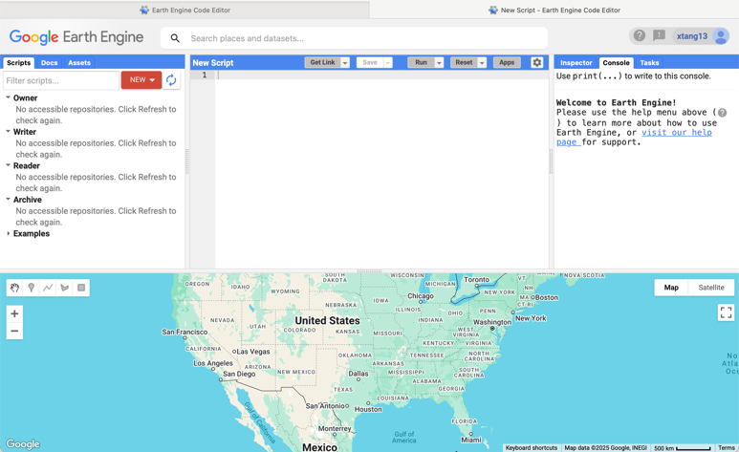
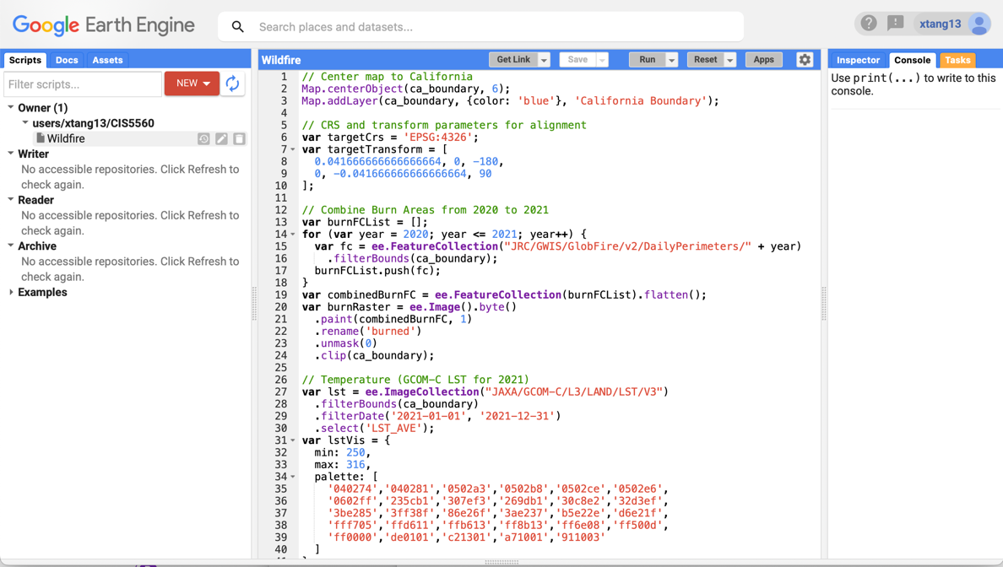
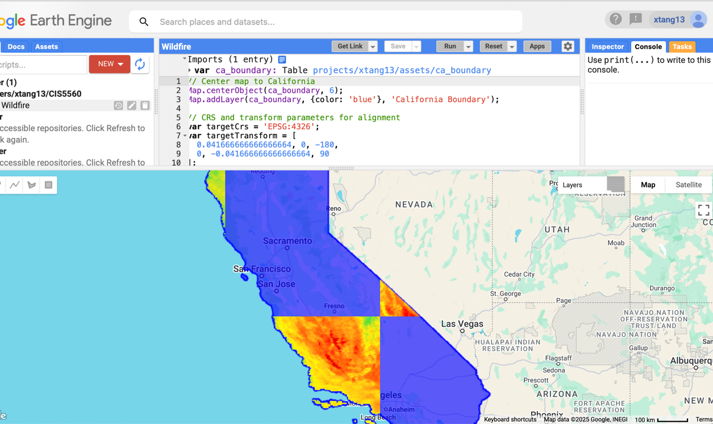
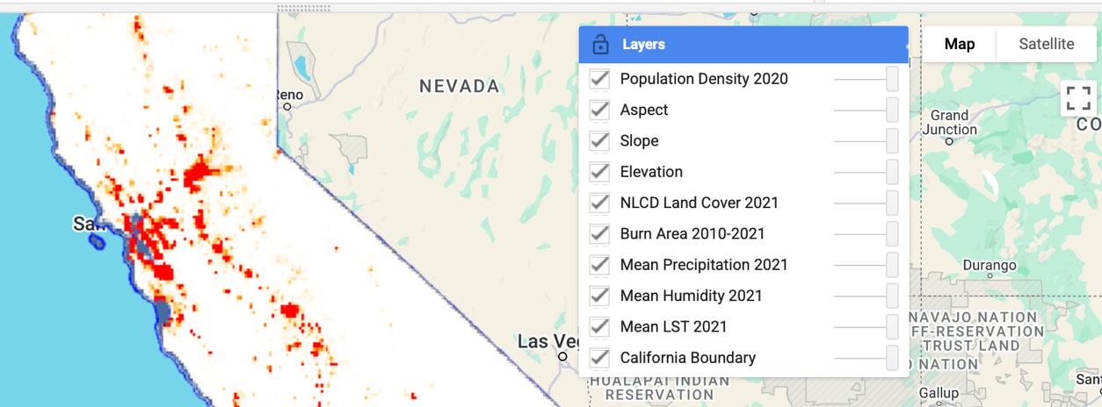
Data Process- Assemble Feature Datasets
https://code.earthengine.google.com/ Google Earth Engine
Click the link below and Copy, open your “Wildfire” file and paste the code in your file, click “save”: https://code.earthengine.google.com/b051fbee34a38fa7bfc404cd5885cf21
https://github.com/xuewentang/cis5560/blob/main/dataset/ca_boundary.zip download the “ca_boundary” zip file which is the shape file of California State.
Import the shape file and Click the “Run” button on the Wildfire Script.
You can see the “Layers” and see the datasets we select to use.
When you finish the process, you can find the output of the datasets you need from your cloud. Click “Open in Drive” and you can download the cleaned dataset: California_Multiband_Environmental_Layers_2021.tif from Google Drive.

Slide 12
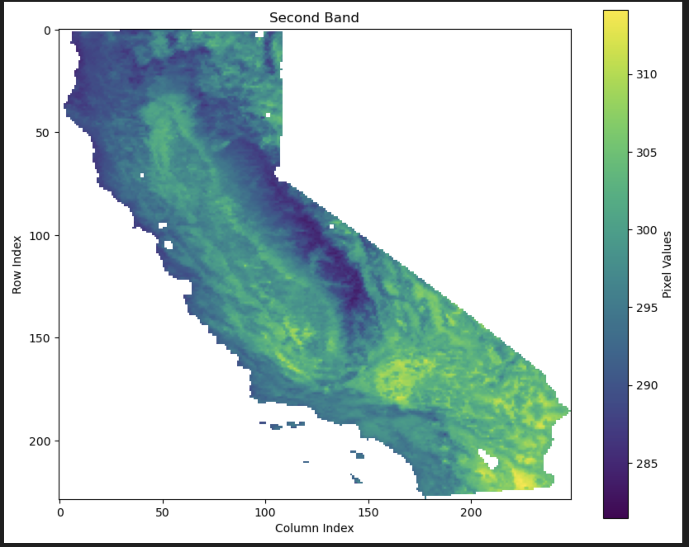
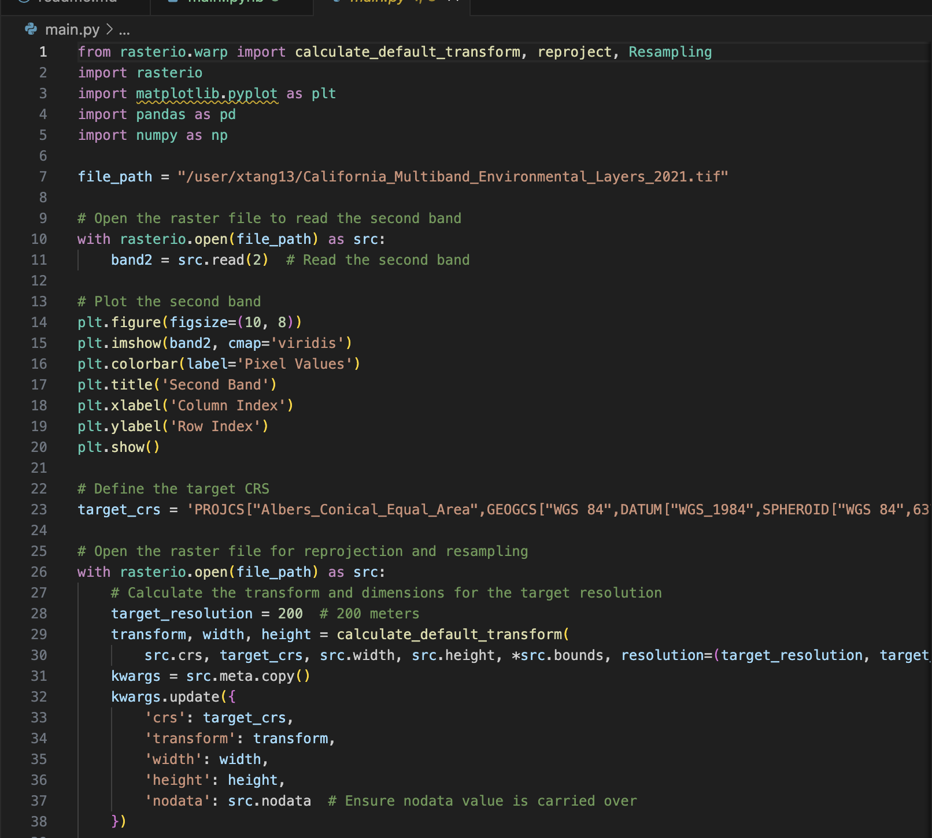
Data Clean- Raster Image Resampling
Python language
from rasterio.warp import calculate_default_transform, reproject, Resampling
import rasterio
# Open the raster file for reprojection and resampling
# we resampling the raster file for the pixel resolution from 4miles to 200 meters:
target_resolution = 200 # 200 meters
# Create a new file to store the reprojected data
# Create row and column indices for each pixel
# Create a DataFrame from the reshaped data and include row and column indices
# Save the DataFrame to a CSV file
csv_file = 'reprojected_resampled_raster_with_indices.csv’
df.to_csv(csv_file, index=False)
print(f"CSV file saved as {csv_file}")
# CSV file saved as reprojected_resampled_raster_with_indices.csv 1.5GB

Slide 13
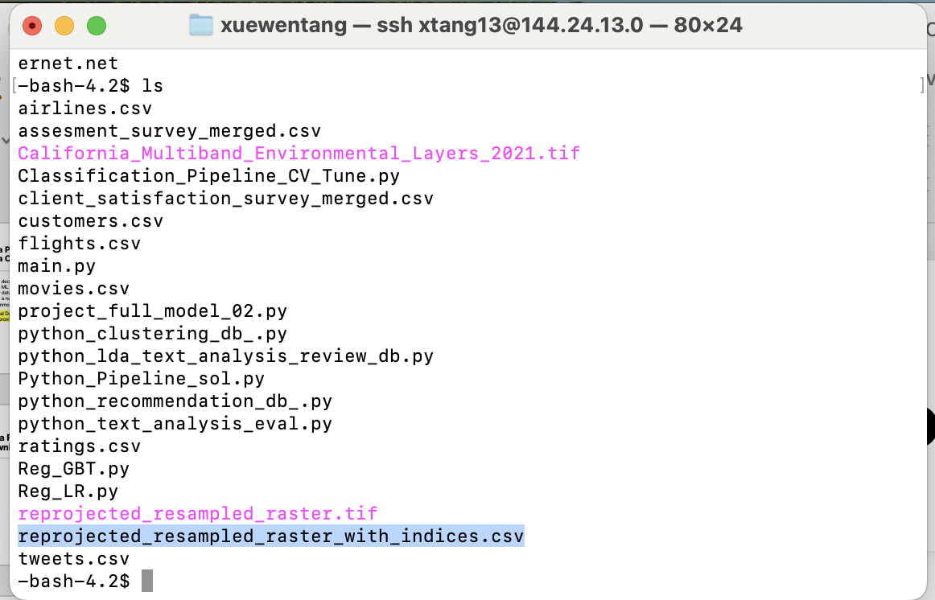
Data Upload-Hive
Upload the file “reprojected_resampled_raster_with_indices.csv” from raster image resampling to hdfs:
scp /Users/xuewentang/Desktop/reprojected_resampled_raster_with_indices.csv xtang13@144.24.13.0:~

Slide 14
Data and Server Specifications
Project Idea Explanation
Project Architecture and workflow
Data Process
Machine Learning Model Building and Testing

Slide 15
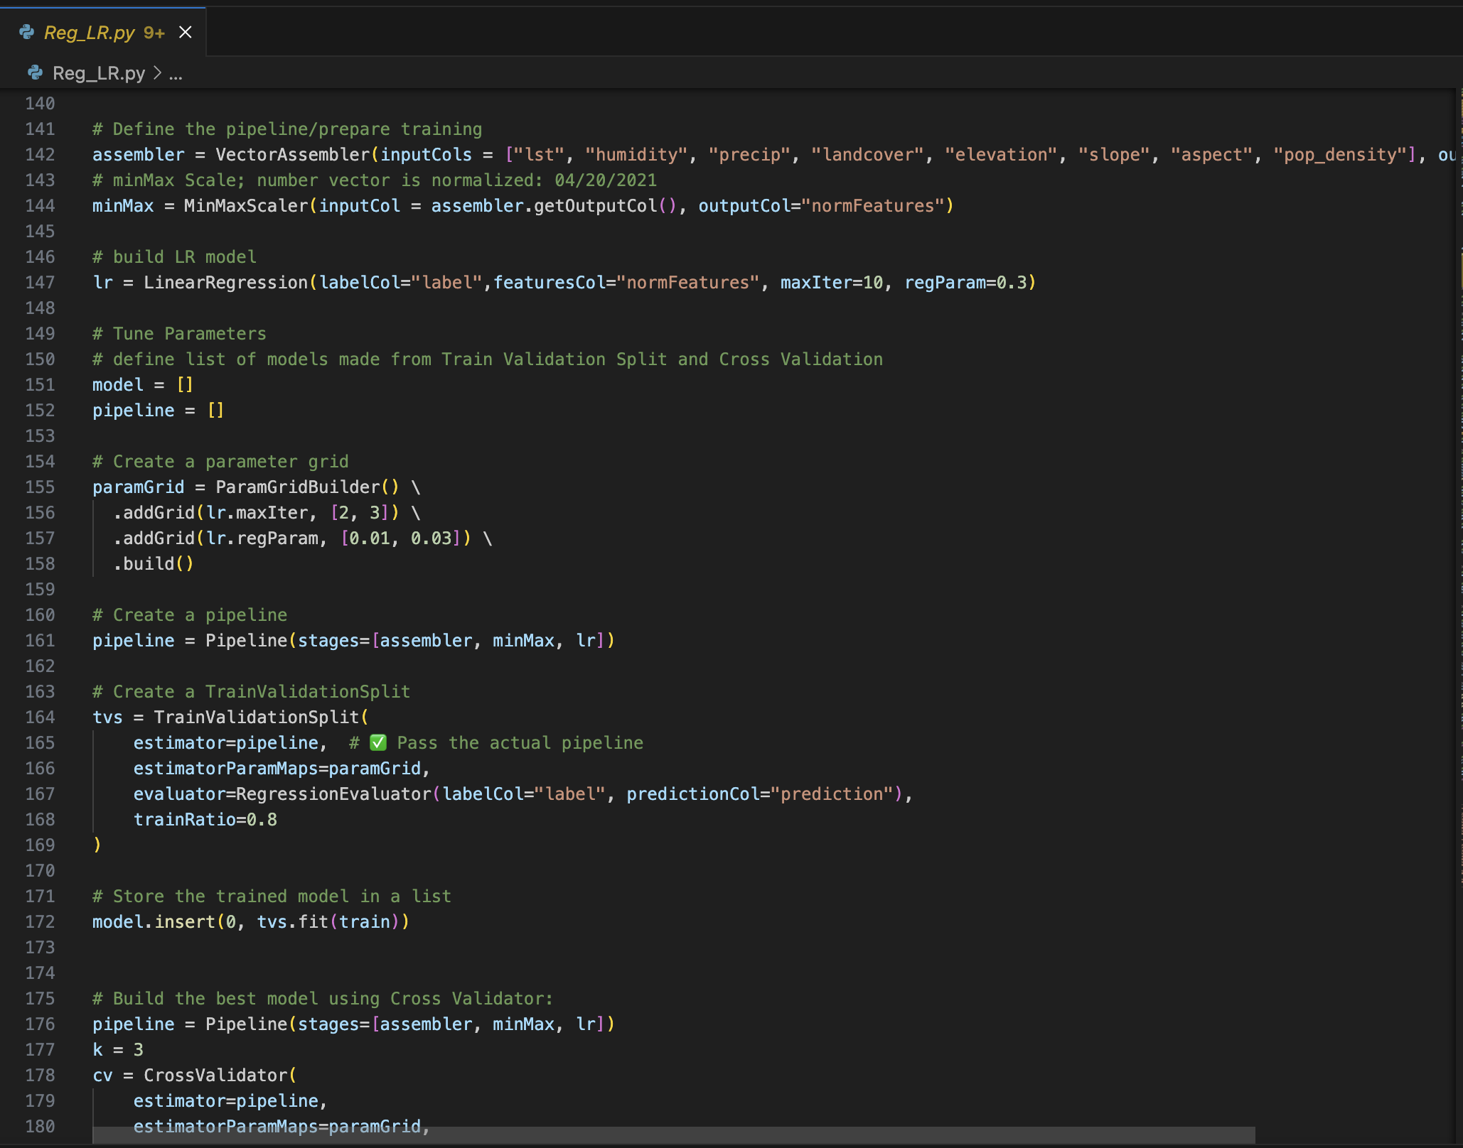
Regression- Linear Regression
RMSE: 0.2361
R2: 0.0841
Feature Importance
Precipitation: 0.347238
Time Calculation: 224.64 Seconds

Slide 16
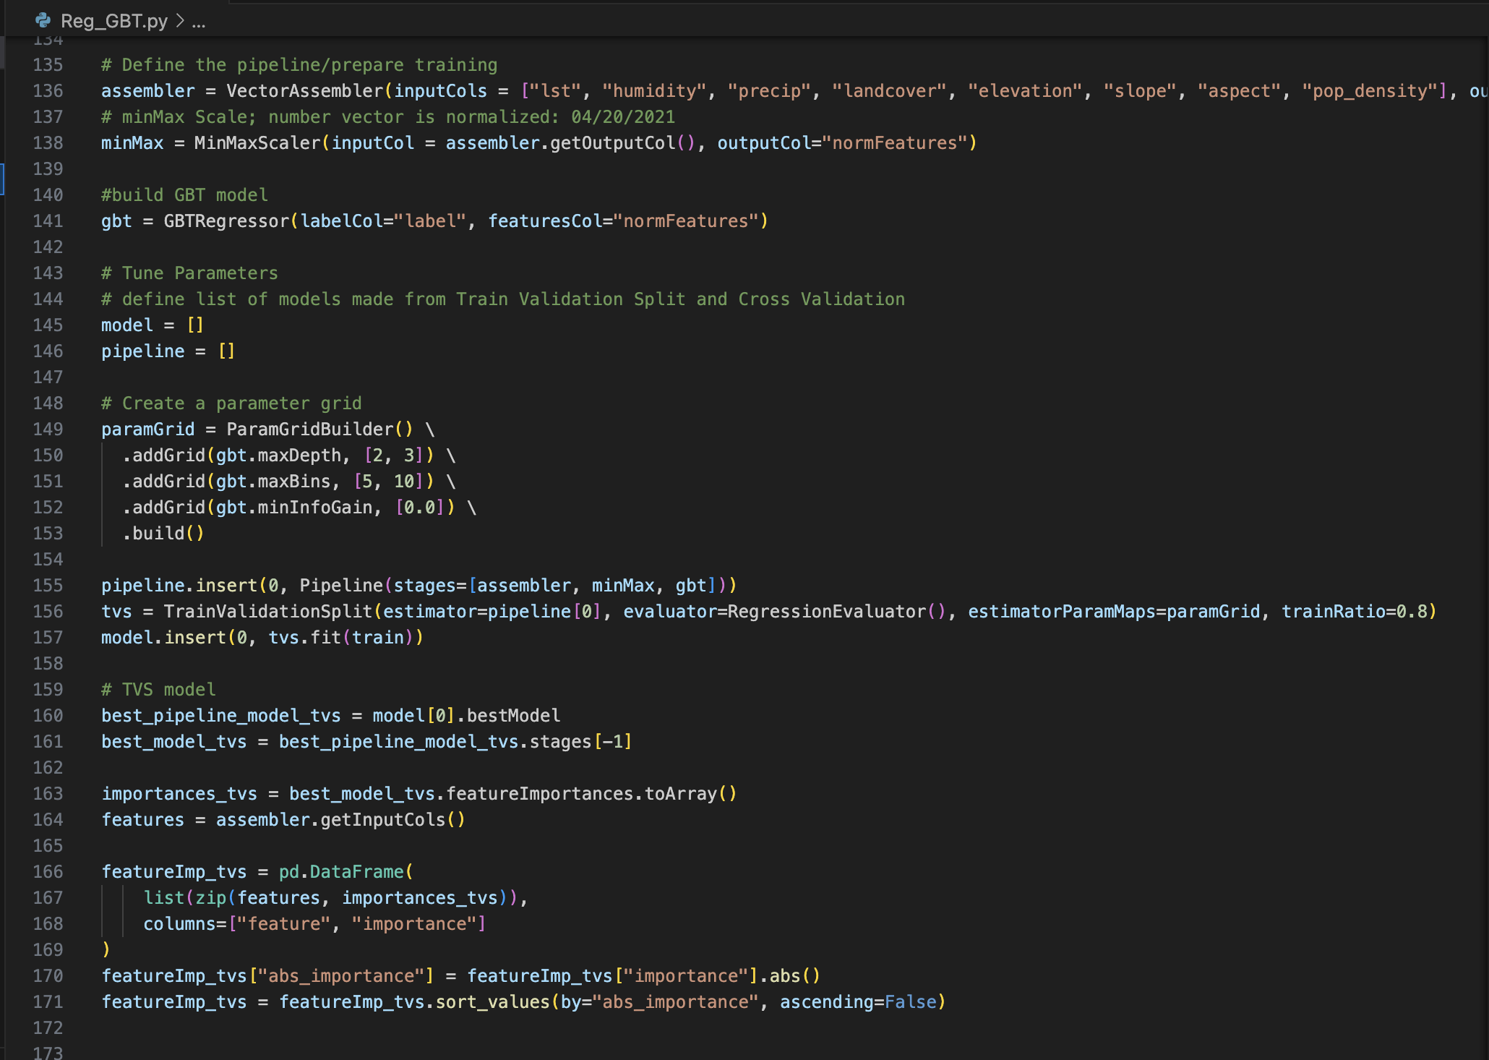
Regression-GBT
TrainValidationSplit
RMSE: 0.21048852442958974
R2: 0.2715590437174674
Feature Importance – Precipitation: 0.205551
CrossValidator
RMSE: 0.21669416323216747
R2: 0.22797398389632684
Feature Importance – Landcover: 0.388587
Time Calculation: 674.32 Seconds

Slide 17
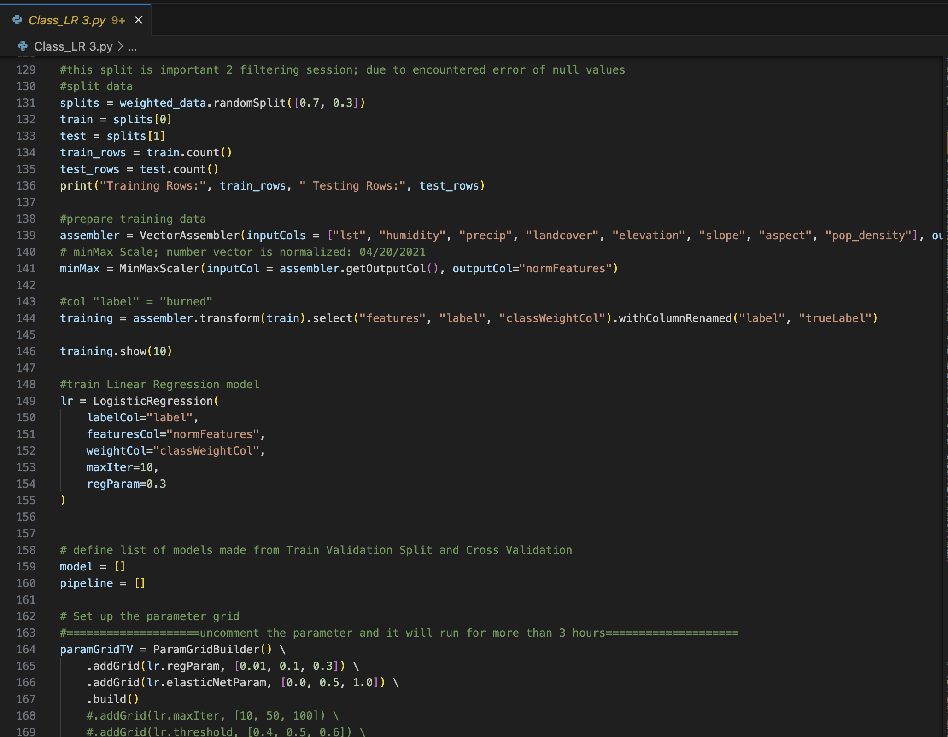
Classification-Logistic Regression
Model | Precision | Recall | F1 Score | Accuracy | AUC
TrainValidationSplit | 0.1620 | 0.7413 | 0.2659 | 0.7338 | 0.8154
CrossValidator | 0.1743 | 0.7487 | 0.2828 | 0.7529 | 0.8226
TrainValidationSplit
Feature Importance – Population Density: 4.6024
CrossValidator
Feature Importance – Population Density: 12.9363
Time Calculation: 3621.46 Seconds

Slide 18
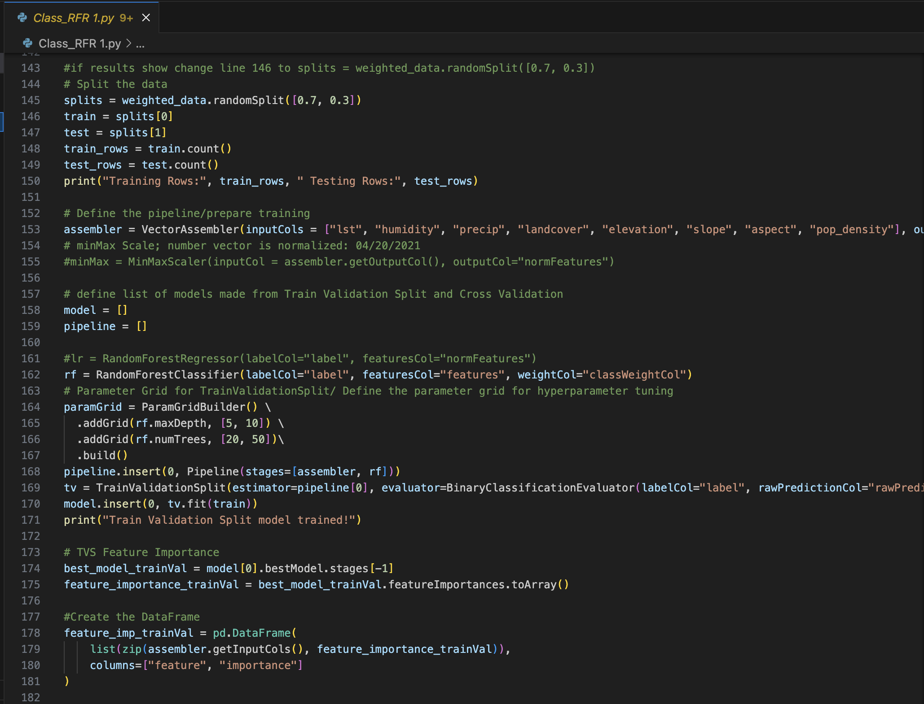
Classification-Random Forest
Model | Precision | Recall | F1 Score | AUC
TrainValidationSplit | 99.78% | 91.22% | 93.02% | 98.30%
CrossValidator | 100.00% | 96.93% | 97.36% | 99.95%
TrainValidationSplit
Feature Importance – Landcover: 0.302987
CrossValidator
Feature Importance – Landcover: 0.195154
Time Calculation: 1067.86 Seconds

Slide 19
Best Model
Best Model:
Classification-Random Forest (CrossValidator): High AUC, Precision, and Recall
Poor Model
Classification-Logistic Regression: Low Precision
Regression-GBT Regression: Lower R2 performance
Regression-Linear Regression: Lowest R2 performance, highest bias

Slide 20
Feature Importance Comparison
Model | Method | Feature Importance | Value
Regression-Linear Regression | Same Parameter | Precipitation | 0.347238
Regression-GBT | TrainValidationSplit | Precipitation | 0.205551
Regression-GBT | CrossValidator | Landcover | 0.388587
Classification-Logistic Regression | TrainValidationSplit | Population Density | 4.6024
Classification-Logistic Regression | CrossValidator | Population Density | 12.9363
Classification-Random Forest | TrainValidationSplit | Landcover | 0.302987
Classification-Random Forest | CrossValidator | Landcover | 0.195154

Slide 21
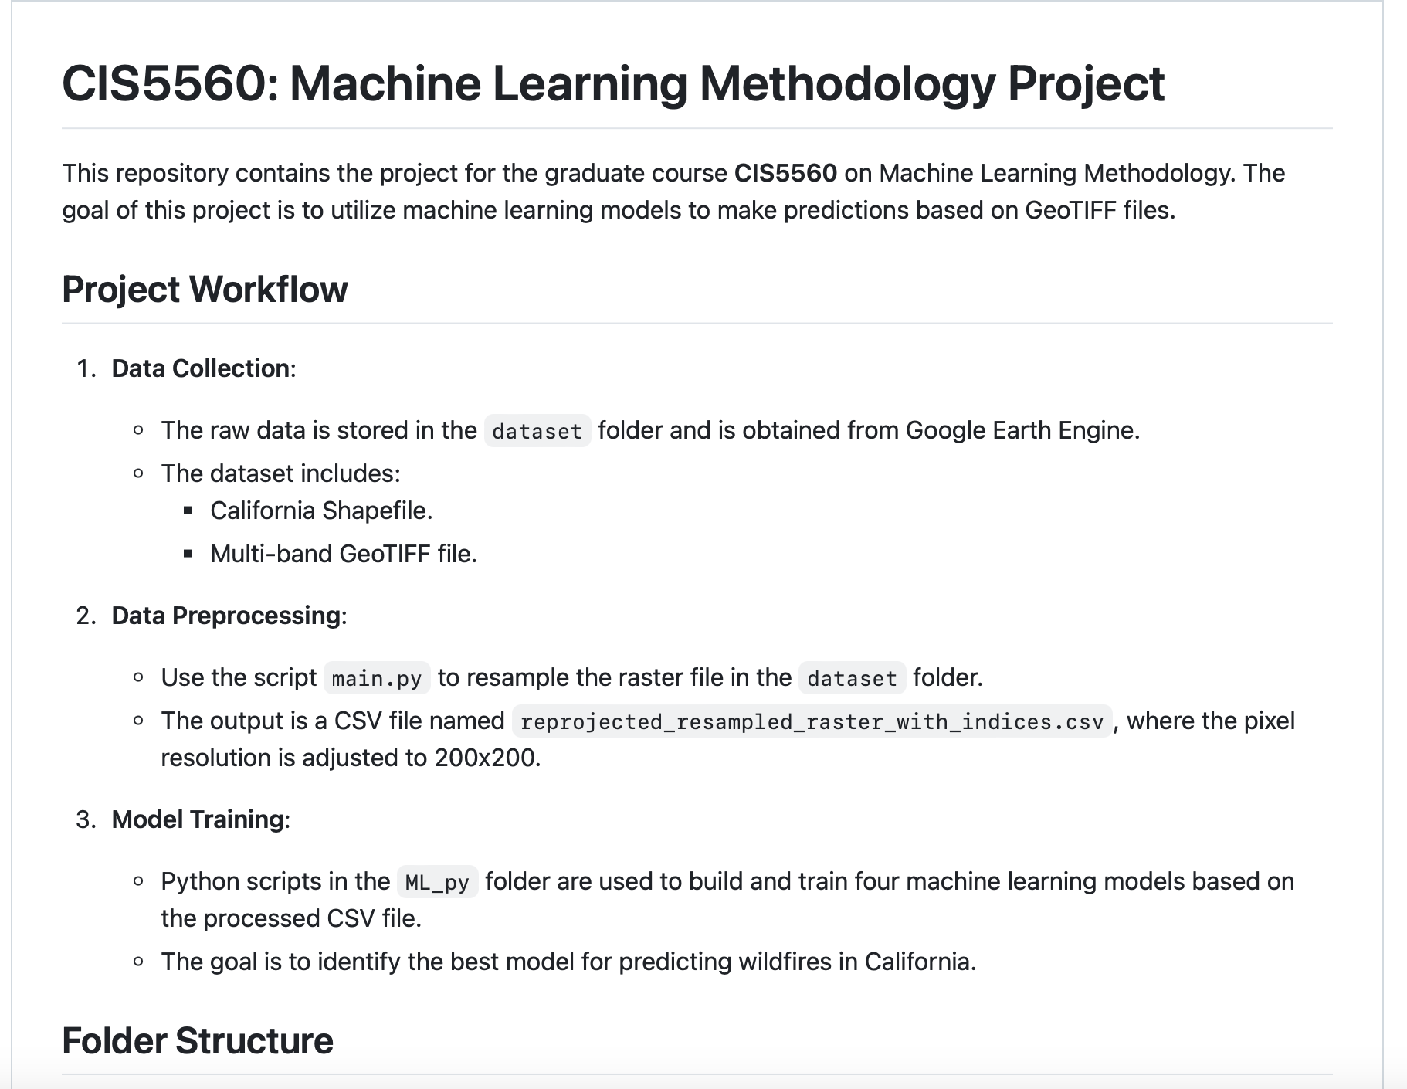
5560group6 GitHub https://github.com/xuewentang/cis5560
THANK YOU

